Slide 1
OTP Authenticator
Varun G
Ayan B M
Prathiksha
Kanthimathi C
Sharath Kumar U K

Slide 2
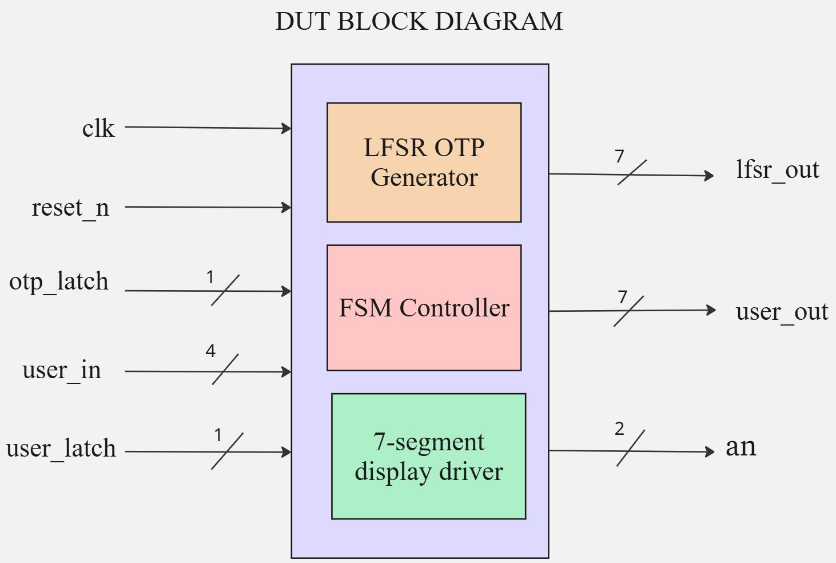
BLOCK DIAGRAM

Slide 3
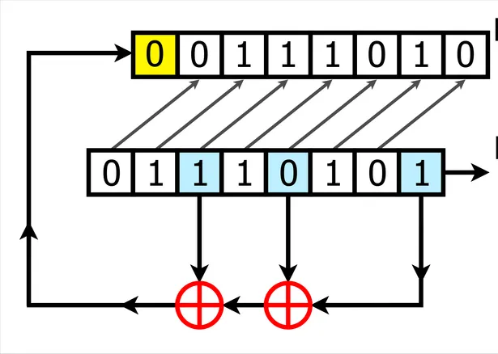
LFSR(Linear Feedback Shift Register)
Tap bits - 0,3,5
From spec:
Tap bits: [15, 13, 12, 10, 8, 6]
Reset value: 0xACE1
OUT

Slide 4
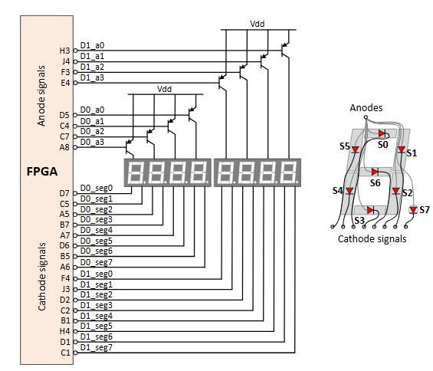
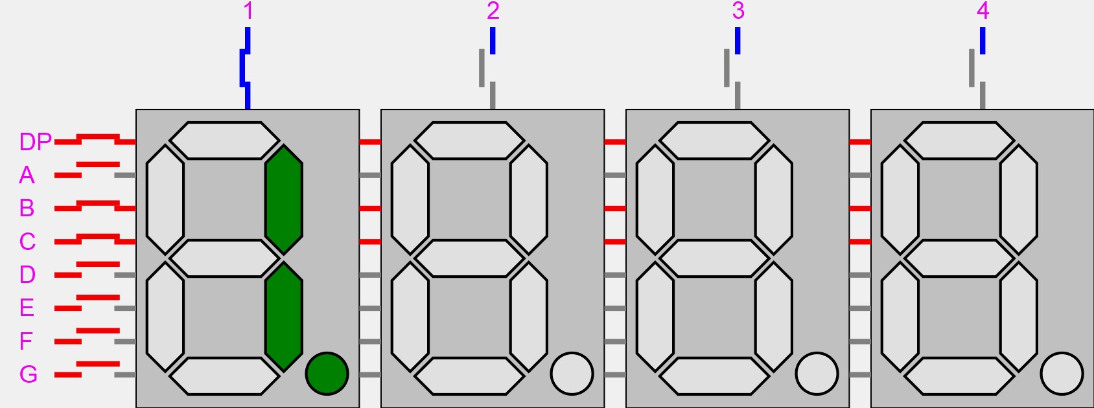
7 SEGMENT MULTIPLEXING

Slide 5
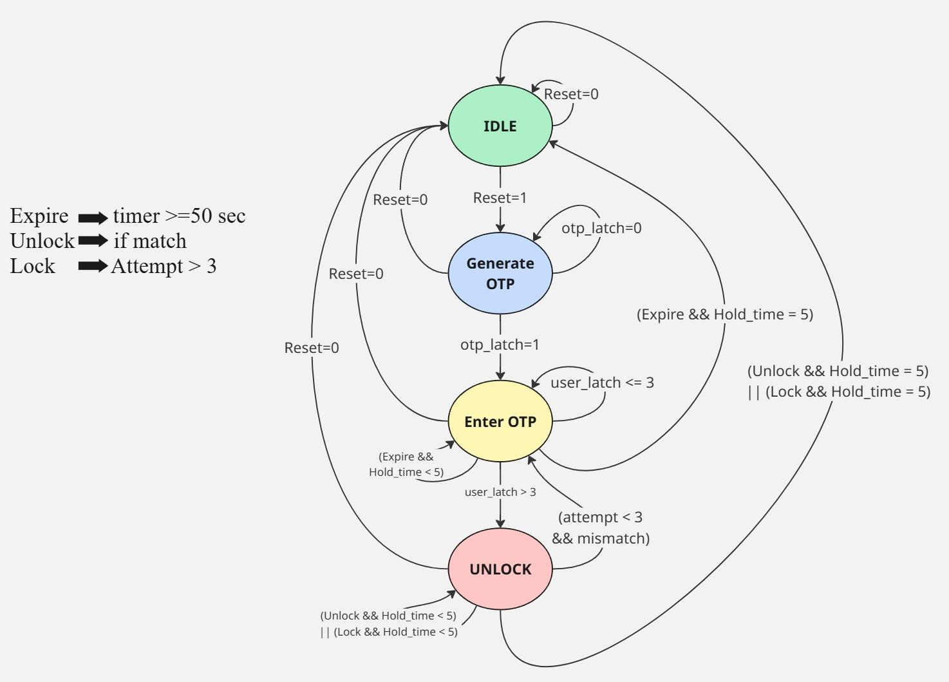
FSM

Slide 6
SIGNAL DESCRIPTION
Signal | Direction | Width | Description
clk | Input | 1 Bit | System clock
reset_n | Input | 1 Bit | Active-low Asynchronous reset
user_in | Input | 4 Bit | User-entered digit (0-9)
otp_latch | Input | 1 Bit | Captures current LFSR
user_latch | Input | 1 Bit | Captures user digit into user register

Slide 7
lfsr_out | Output | 7 Bit | Decoded output of LFSR for 7-segment display
user_out | Output | 7 Bit | Decoded output of USER for 7-segment display
an | Output | 2 Bit | Anode Output for 7-segment display

Slide 8
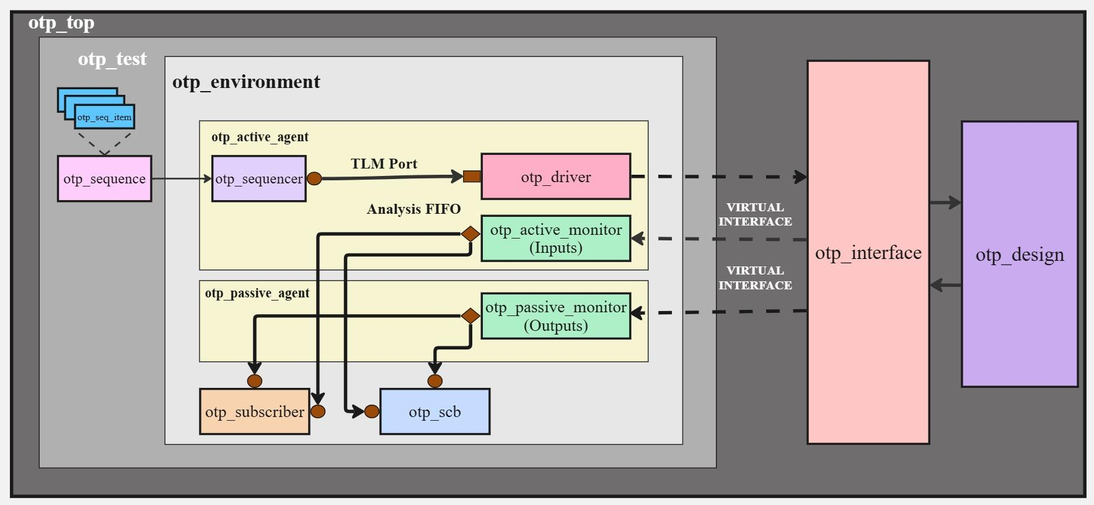
TESTBENCH ARCHITECTURE

Slide 9
BUGS IN DESIGN
S.NO | DESCRIPTION
1 | The expiry flag timing as per the specification is 50 seconds, but during testing, the flag was raised at 50 sec 20 ns — one clock cycle later than expected.

Slide 10
CHANGES IN SPECIFICATION
S.NO | DESCRIPTION
1 | DUT works on posedge detection logic for otp_latch and user_latch signals, but this was not mentioned in the specification.
2 | The master clock frequency used in the design was specified.
3 | The application and usage of the HOLD_TIME parameter within the design are specified.
4 | The representation of FSM outputs (LOCKED, UNLOCKED, EXPIRED) on the 7-segment display is documented.
5 | The tap bit positions for the 16-bit LFSR implementation are detailed.
6 | The behavior of the 50-second inactivity timer is clarified — whether it resets after each user attempt or applies cumulatively across all attempts.
7 | The clock divider frequencies used for driving the 7-segment display are defined.
8 | The FSM transition condition from IDLE to GENERATE_OTP state is explicitly defined.

Slide 11
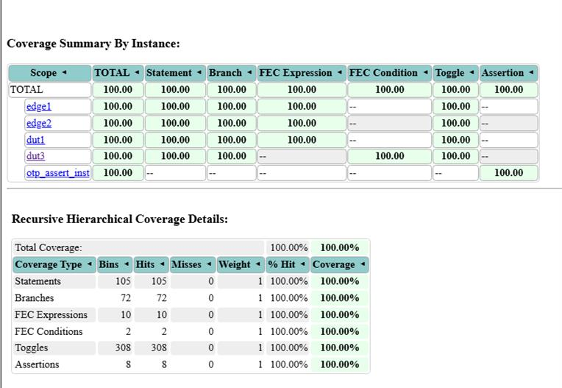
CODE COVERAGE

Slide 12
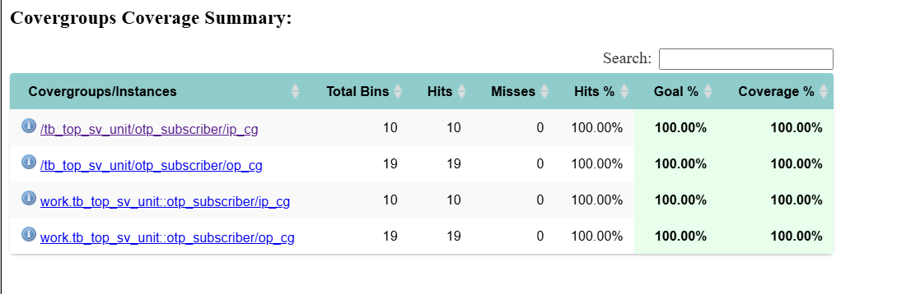
FUNCTIONAL COVERAGE

Slide 13
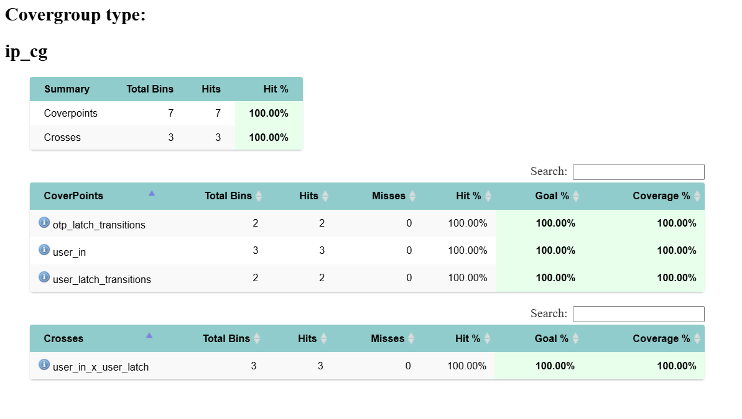
INPUT COVERAGE

Slide 14
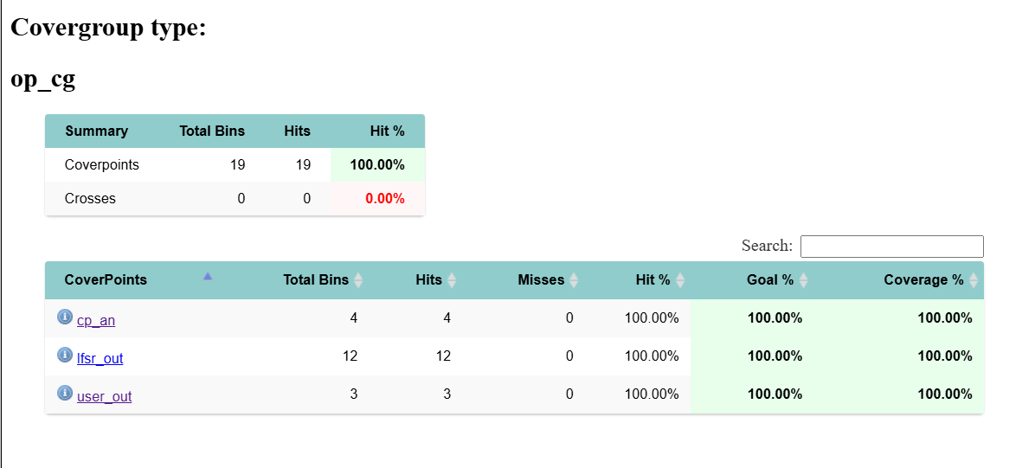
OUTPUT COVERAGE

Slide 15
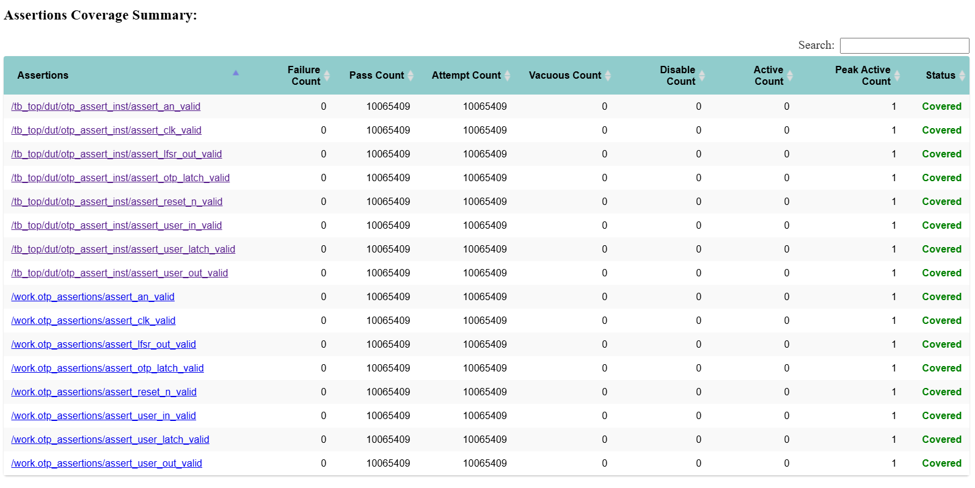
ASSERTIONS

Slide 16
TEST PLAN LINKS
Test Plan:Test Plan
Coverage Plan:Coverage plan
Assertion Plan:Assertion plan
DUT Corrections: DUT corrections

Slide 17
THANK YOU

